Slide 1
Poster Presentation
Poster is an effective form of Scientific communication
Poster session in any scientific meeting can accommodate larger number of papers.
An effective poster takes time to prepare
Therefore organizers of the meeting have responsibility to plan the poster session in a way that the presenter and viewers get most out of it.
Sufficient time (not overlapping with oral presentations) should be allotted to poster session.
The major benefit of this form of scientific communication is meaningful dialogue with the author

Slide 2
Advantages of poster presentation
Main messages can be highlighted
Viewers can study the information at their own pace.
Poster presentation as compared to oral presentation gives better opportunity to viewers for asking questions and have meaningful dialogue with the author.
The poster can be reused e.g. in author’s host institution.

Slide 3
An Awesome Scientific poster
A scientific poster is a work of art.
It successfully combines two rather unrelated fields: science and graphic design.
Not only should everything on a poster be accurate and correct, it should also be easy to understand and pleasing to look at.
Unfortunately, most scientific posters fail on the latter two criteria.
It is common to see posters crammed with text and data, often illegibly small.
Figures lack legends or labels, and are copied straight from an article.
A clear introduction or conclusion is missing. All of this forces viewers to quickly lose their attention and move away.

Slide 4
How to attract viewers
Generally in poster sessions the number of posters are very large, therefore you have to make viewers curious and interested to look at your poster, but for this you have very little time.
The wording of the title and overall appearance of your poster should be attractive.
There should be a brief clear message in your poster to catch interest of audience.
Viewers will ask further questions and look for more details if the main message is clear to them.
Like oral presentation , the poster should also be compatible with viewers interest

Slide 5
What should a poster display?
Why the topic is important?
Main objectives of the study
Methodology used.
Most important results.
Main conclusion
Possible implications
Mention methods briefly, emphasize main results with help of visuals, conclusion should form the main part of the poster
According to space available you can make the introduction short but do,nt curtail objectives.
If you overload your poster with lot of information the viewers may miss the “take home” message.
Give a handout to those interested in details

Slide 6
How to design the poster?
Before starting look for organizer’s directions carefully and plan accordingly.
Get everything right, if the poster is to be in portrait don’t make it in landscape, otherwise you land in trouble.
Follow organizers instructions if it suits you, otherwise follow your own pattern.
Use your imagination to make an attractive and informative poster
The key to successful poster presentation is simplicity

Slide 7
Selecting the layout and content of the poster
The general layout of poster is under headings, objectives, methods, results and conclusions, but you can use more informal settings i.e. short statements or questions to bring novelty.
Before deciding the layout you may set up a one page model in proportional scale on paper or on your computer
Arrange the content in a lucid way, in columns or rows or in circles (clockwise/anticlockwise)
If relatively enough space is available , put content in columns
This makes easy for viewers to see while walking from left to right , specially when there are large number of viewers.
Always put the title and names/address of authors at the top
Use same title and no. as given in the meeting program

Slide 8
Layout and content………..(contd)
Poster should be self explanatory
Put content in logical order
The most important portion (conclusion) must be highlighted and put at a location where viewers find it easy to read
Visuals e.g. figures, tables, clip art etc make your poster attractive but these must express your real story
A balance between text and visuals has to be achieved in accordance with the size of the poster
A unifying background is needed which separates it from poster board and neighbouring posters
A multi-part poster having each element on multi coloured card board or a single sheet poster can be made
A sub-background colour can be used for each group of data , which should be in harmony with the main background
In order to highlight part of poster choose contrasting colour
It is best to keep the background light i.e. light grey or biege for the text and not pure white

Slide 9
Selective messages on poster
Each section of poster must contain just a few important messages.
Do,nt write complete sentences, just few meaningful words
Example: Material and methods printed summary for handout,
Two hundred patients regularly attending heart clinic at Royal hospital were randomly classified in two groups of 100 each. One group was asked to take two eggs per day for 30 days and the other group acted as control. Blood sample was collected from each patient on day 0 and 30 for plasma cholesterol analysis. Patients were weighed at the time of sampling.
Description of material and methods in the poster:
Treatments (30 days duration)
(n=100) 2 eggs per day
(n=100) Control
Measurements(day 0 and 30)
Plasma cholesterol
Body weight

Slide 10
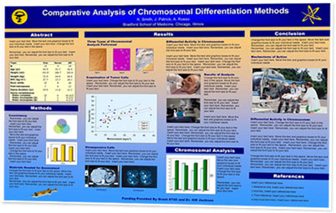

Slide 11
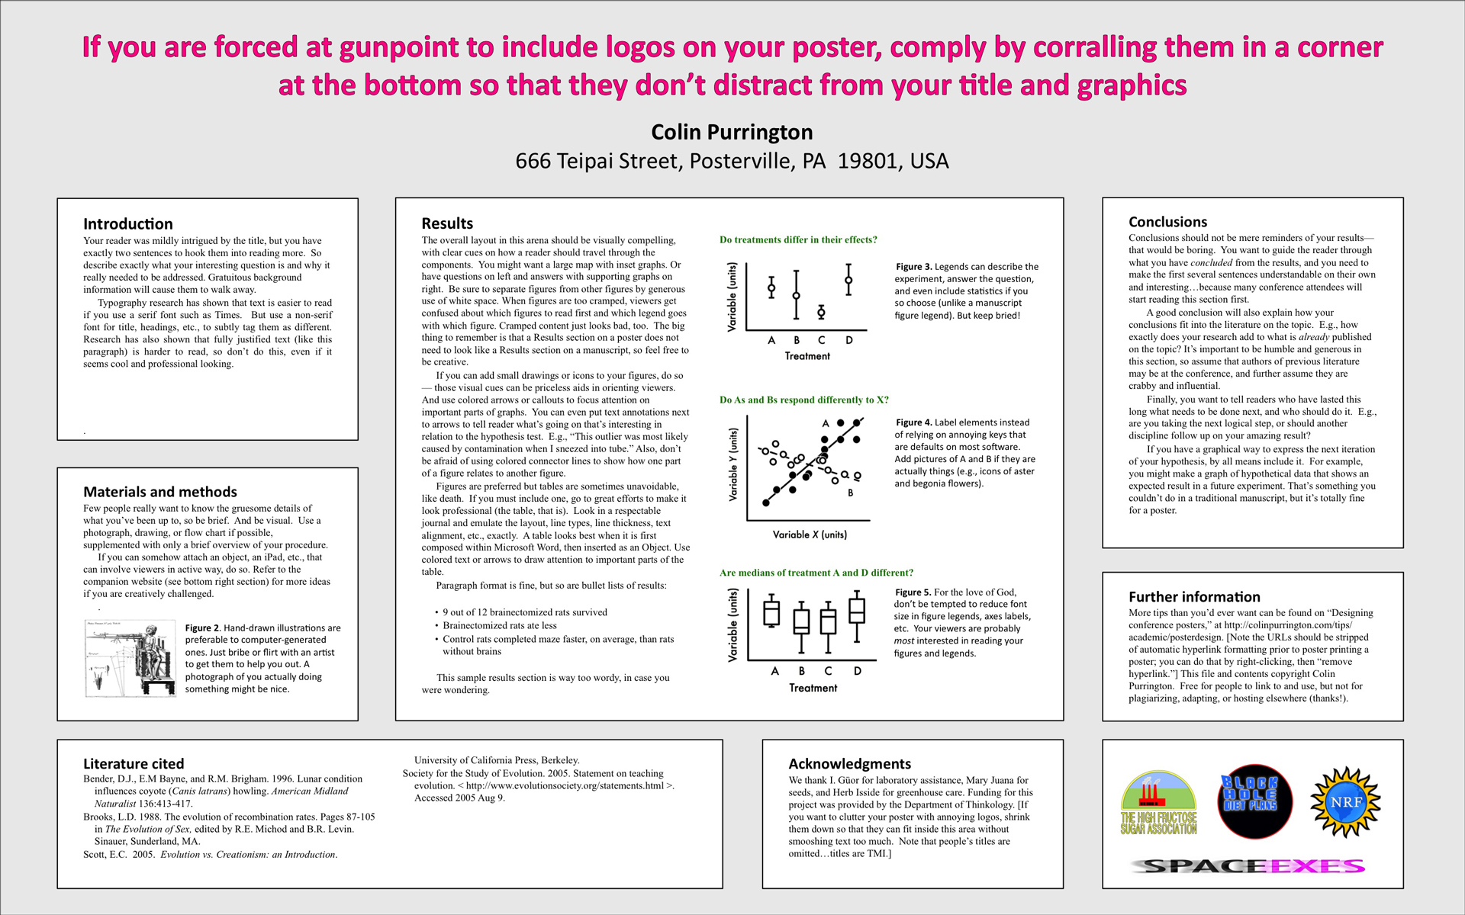

Slide 12
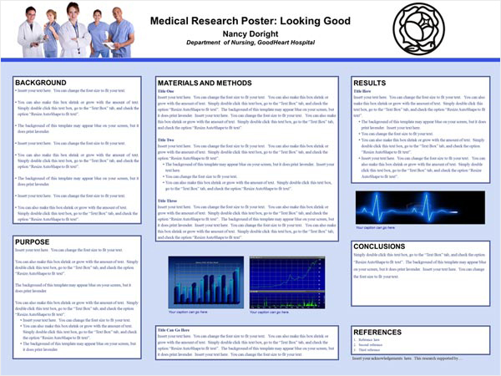

Slide 13
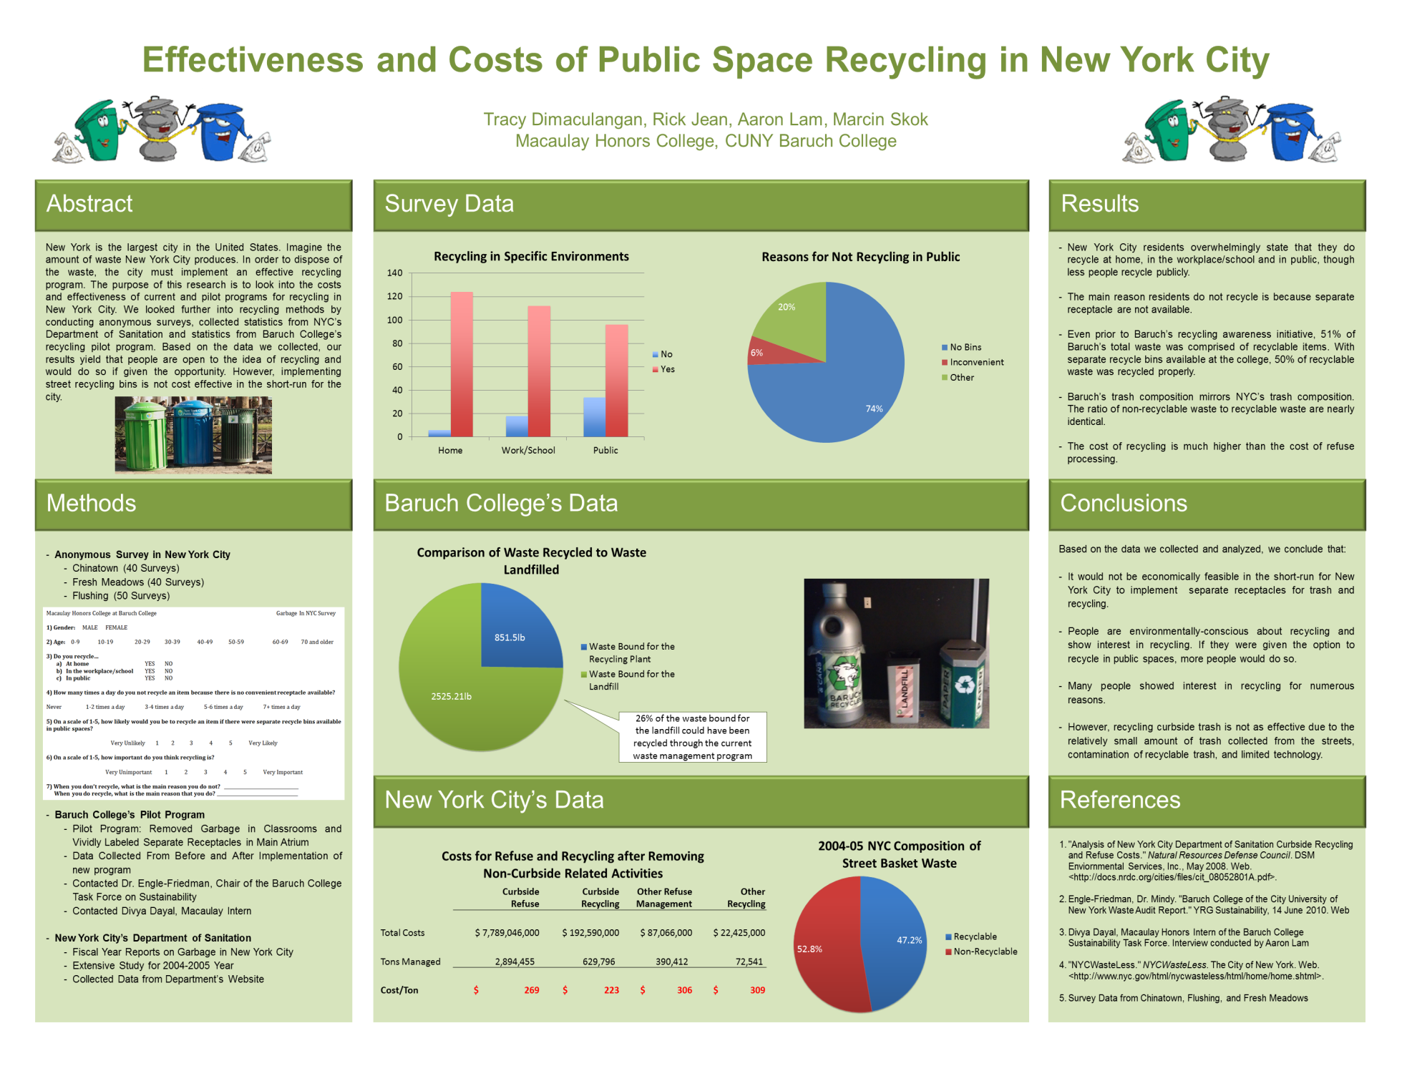

Slide 14
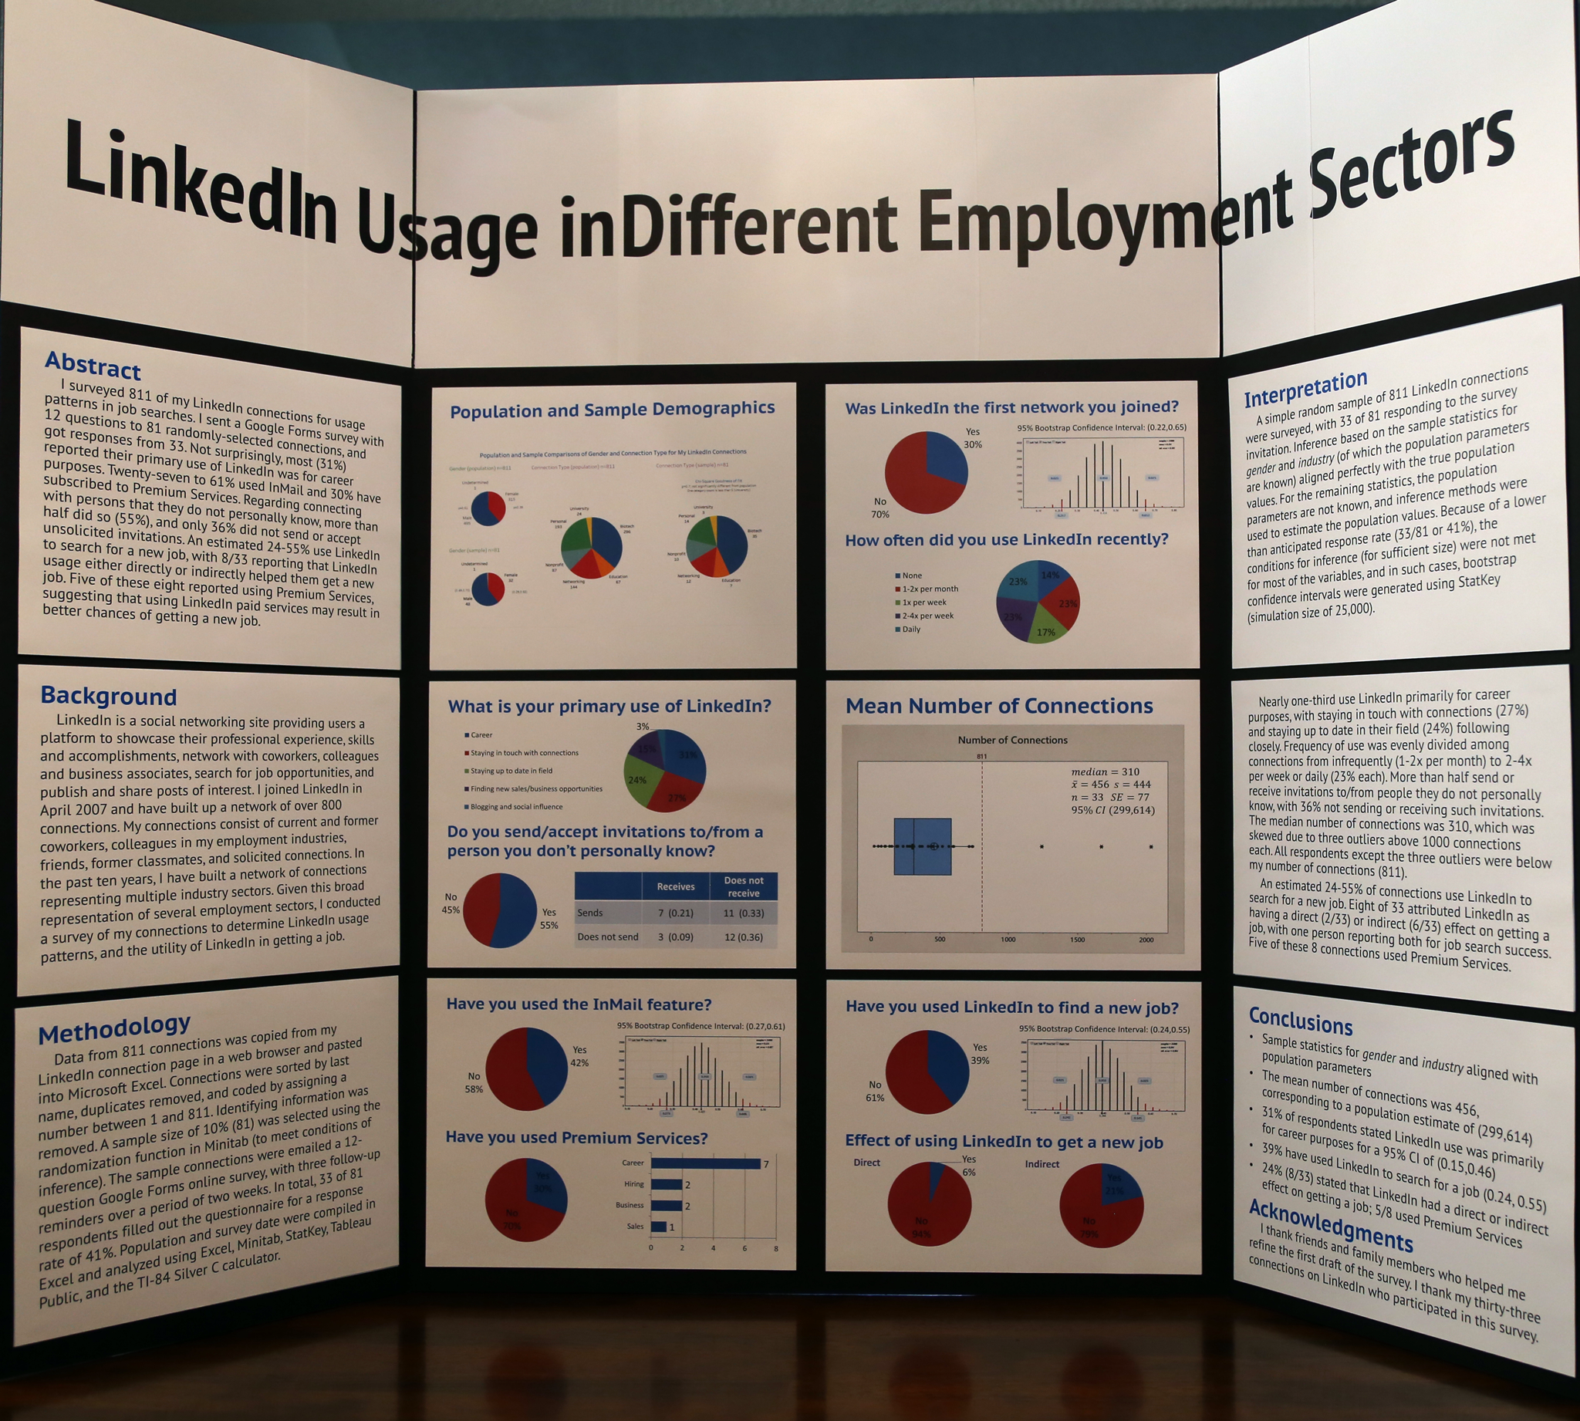

Slide 15
How to make a poster
A poster can be created in several ways, two of these are,
Multi-part poster
Single sheet poster
Multi-part poster: Individual elements are produced separately (usually on computer)and introduced on a unifying background(paper or card).The background paper is pasted onto a cardboard or foam-core board.
To make the poster more alive, some parts e.g. photographs, illustrations are attached (pasted) so that these stick out from the background.
A multi-part poster is split into segments for easy transport The final mounting is done at the meeting, when the segments are joined with tape on the back
The final mounting is easier if the segments are taped and folded in pairs before transport

Slide 16
Making a poster
2. Single sheet poster
It can be created on computer , then printed on a special printer to get the desired size.
It is printed on paper and then covered with plastic laminate.
A poster cylinder is needed during transport
Single sheet poster is easy to mount at the meeting , but printing it may be expensive
Never enlarge your written paper to a poster, since it looks unattractive and unprofessional

Slide 17
10 steps to create an awesome poster (Step 1)
Tell a story
Start on a blank piece of paper . Before opening your favorite software and jumping into the lay-out, take enough time to think about the story you want to tell your audience.
Define a single key message you want your audience to remember. If someone would ask them: “What did you learn today?”, what would you want them to say? Remember, your message should be relevant not only to you, but also to your audience!
Around this key message, add layers of context as if you were writing an abstract: an introductory sentence, a problem you want to solve, and your methodology to do so.
Add your main results, and the conclusion you can draw from them. In what way did you solve the initial problem? This is the story your poster should tell. Nothing more, nothing less.

Slide 18
Provide context (step 2)
When crafting your story, don’t forget to add context.
Why are you doing this research?
What is the scientific and societal relevance?
What is the current situation, and in which ways does it differ from the ideal situation?
This is the need, the problem (or one of the problems) you are trying to solve with your research.
Without the relevant context, your audience will not know why your research is important, and they will not be motivated to learn about your results and conclusions.

Slide 19
Draw meaningful conclusions (step 3)
End your story with a meaningful conclusion.
Refer back to the context: in what way did you solve the initial problem?
Which steps did you take towards a solution?
Did you raise additional questions, which should be tackled in further research?
Don’t forget to add a message to your conclusions, rather than sticking to mere numbers.
A 10% increase of something is nice, but is it good or bad? Is it something you expected, or is it unusually large or small?

Slide 20
Remove unnecessary matter (step 4)
People never have enough time. At a conference poster session with tens, often hundreds of posters, they are not willing to spend fifteen minutes reading your poster from A to Z. Therefore, remove everything which is not relevant for the story you want to tell. Keep the focus on your key message. Use short, compact sentences.
Sure, you have done a massive amount of great work, but if you try to put all of it on your poster, the amount of information will be so huge that nobody will bother to read it. They will lose their attention and move on to the next poster.
Pro tip: A great way to save some space on your poster is by removing your references and putting them on a separate handout page. If people are interested enough to look up your references, they don’t have to write them down or take a picture.

Slide 21
Choose an informative title (step 5)
The title is your first and best way to get your audience’s attention. In just a few seconds, they should know what your story is about. Make sure to avoid difficult words or abbreviations, keep it clear, concise and simple.
Don’t be afraid to choose a title that gives away your key message. If the title is all your viewers read, make sure it will be one they will remember.

Slide 22
Layout of Poster should match your story (step 6)
Now it is time to open your favourite software and create a layout. The simplest design is often the most effective, for example: white rectangular blocks on a lightly colored background.
Make sure not to put blocks where they fit, but keep the flow of your story in mind. Create a logical structure starting with your introduction and working your way towards your conclusions.
Pro tip: Finding the right colors can be one of the hardest tasks when designing your poster. Several websites and tools are available to help you in finding a great color scheme. One such example is coolors.co.

Slide 23
Optimize visuals (step 7)
Pictures say more than thousand words… and therefore they are invaluable on a great poster – just like in a journal article. But don’t be tempted to simply copy figures from an article onto your poster. They are completely different media, with completely different requirements.
Figures and tables must be easy to read and to understnd.
Your poster and photographs should preferably have matt surface since glossy surface makes your poster difficult to read.
A striking photograph can be an attention-getter. The presenter can put his/her photograph near the title to help audience to identift author for asking questions
Take your time to craft your poster figures from scratch. Pay attention to readability and simplicity. Use a large enough font, remove unnecessary details, don’t forget your legend. Again, make sure that every figure supports your story and helps to convey your key message.
Write meaningful captions. Rather than a description of what’s on the figure, provide an interpretation. In this way, readers can follow the story simply by moving from figure to figure, caption to caption.
A take home message near the table or figure might also help

Slide 24

Make it easy for audience (step 8)
It’s your job to ensure that the viewers don’t have a hard time reading the text on your poster. To achieve this, the key to success lies in the details, most importantly the font size and the linewidth (the distance between two consecutive lines).
Other important factors to optimize: the line length, which should ideally be around 50 characters (that’s twice the alphabet) and the whitespace around your titles and paragraphs. As a rule of thumb, if you print your poster on an A4 sheet, and you hold it at arm’s length, it should be easy and comfortable to read everything – yes, that includes axis labels, legends and references!
For printed media such as posters – serif fonts (e.g. Times New Roman, Cambria or Garamond) are easier to read than sans-serif fonts (e.g. Arial, Calibri or Verdana). (a serif is a small line attached to the end of a stroke in a letter or symbol e.g.
Bold letters in the title and headings can facilitate reading from a distance. The title should be readable from a distance of 3-5 meters and the text from 1.5-2 meters.
Font size 110-120 for title, 60-70 for headings and 30-40 for the body text

Slide 25
Practice your presentation(Step 9)
Presenting a poster is not very different from presenting a speech. However, your time is usually much more limited, since people want to visit several tens of posters in a single session. Also, you receive a lot more questions from your audience.
Imagine that someone asks you the following question: “I don’t have time to read everything on your poster, but can you tell me in 30 seconds what it’s about?”. There’s even a good chance you will actually get this question!
As always, keep in mind who you are talking to. Is it a specialist in your field, or maybe in a related field, or is it someone with a completely different background? How would you explain your poster to a layman?
Pro tip: For people who are very interested in your research, provide some handouts: a handy copy of your poster on an A4-sized sheet of paper. On the back, list your contact details and relevant references. Not only does this help people remember your name and your work, but it also saves some space on your poster itself!

Slide 26
Prepare for questions (Step 10)
When people come to your poster, they will have questions for you. Of course, you can’t always predict what people will ask, and you cannot know everything. But you can be prepared.
Take some time to come up with questions your audience might ask after seeing your poster. Ask some colleagues to take a look at your poster and come up with questions. Show your poster to your friends, family or partner and let them ask questions. Think about further research, the details of your methodology, alternative approaches to achieve the same thing,…
Pro tip: Together with your handouts, bring supplementary material! Remember step number 4, where you removed everything which was not strictly necessary? This is the time to bring all your extra figures and data with you, just to be sure. And if you are really feeling confident, why don’t you bring a few copies of your latest article?

Slide 27
Presenting the poster
Bring everything needed for final mounting of the poster e.g. push pins, tape, spray adhesive etc.
Attach a small holder containing your business cards for people who want to contact you later
Copies of Handout may be kept near your poster as interested persons can take these.
A handout may contain reduced copy of poster on one side and on the other authors names, e-mail addresses, contact nos and other relevant details
Arrive in time for poster presentation and stay throughout the session
Your poster should be self explanatory , but you should be prepared to discuss your topic, respond to questions and to provide additional information to audience, if needed.
The poster discussion is different from that in oral presentation. It is more detailed and one-to-one basis
Such a dialogue gives you a wonderful opportunity to establish valuable contacts

